Slide 1
IBM HACK CHALLENGE 2020
TEAM NAME: ILLUMINATI
PROJECT ID: SPS_PRO_682
APPLICATION ID :SPS_CH_APL_20200002611

Slide 2
Optimized Warehouse Management of Perishable Goods for a Food Delivery Company
PROBLEM STATEMENT
A food delivery service has to deal with a lot of perishable raw materials which makes it all, the most important factor for such a company is to accurately forecast daily and weekly demand. Too much inventory in the warehouse means more risk of wastage, and not enough could lead to out-of-stocks - and push customers to seek solutions from your competitors. The replenishment of majority of raw materials is done on weekly basis and since the raw material is perishable, the procurement planning is of utmost importance.

Slide 3

Existing Problem Facts!!
India has the second largest population in the world. Food is essential for human survival, without it we wouldn't live for more than 20 days. The International Food Security and Nutrition Organization suggests that 190.7 million people are undernourished in India. This represents 14.5% of the Indian population, which makes India the home to the largest undernourished population in the world.
“Food waste is an atrocity that is reducible, if not completely avoidable.”

Slide 4
Our Solution
To tackle this problem of food wastage we have decided to focus on the source of food in the supply chain which is a warehouse.
By accurately predicting food demands we can significantly reduce food wastages caused in a warehouse. To solve this problem we have built an interactive website as well as an app
UNIQUINESS:
We would not only be predicting demands but also the expected earnings of the company company will endure in the upcoming weeks. Thus would help in taking important economic decisions according to its total budget.
We would be displaying by how much percentage the company sales would increase if the company decides to promote a product.
Our interactive visualizations will give user a unique experience by also showing the predictions of not only the given week but also 3 upcoming weeks.

Slide 5
Process Flow
When the user enters the website he is prompted to enter some of the basic information about the product whose demand is to be predicted.
As soon as the basic details are entered rest of the details are fetched from the db2 database and displayed in statistics section. The ML Random Forest Regressor model running in the backend give our user the prediction of demand of the product.
The prediction tab would display interactive visualizations of the demand forecasts of the given product over a period of entire month. This would help the company in minimizing wastage and preventing shortage.
The first one is the “product-graph” which forecasts the demands of each product.
The second one is the “earnings-predictor” graph which would predict the earnings of the company.

Slide 6
FLOWCHART
USERS FROM INPUTS
FETCH REQUIRED DATA FROM DATABASE
DISPLAY PRODUCT AND CENTER INFO
DATA PROCESSING
HTTP REQUESTS USING API
DISPLAY FUTURE DEMAND GRAPH
ML MODEL PREDICTIONS
DISPLAY EXPECTED EARNINGS GRAPH
DISPLAY PREDICTIONS AND SALES TIPS

Slide 7
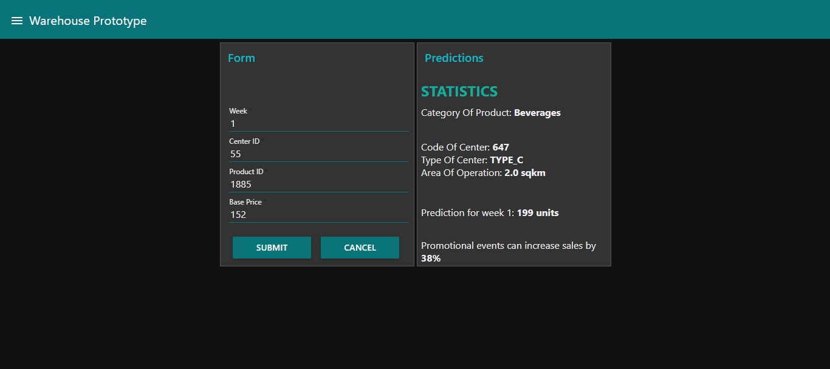
LANDING PAGE

Slide 8
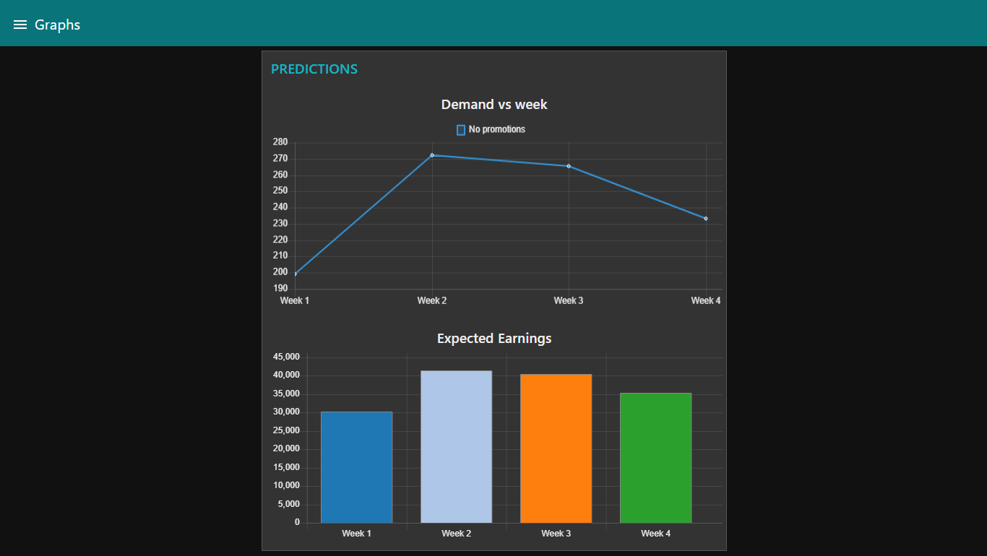
VISUALIZATION PAGE

Slide 9
Social Impact
With the help of accurate predictions, we will prevent the issue of overstocking and understocking thereby preventing the wastage of goods and resources. The company will be able to create a balance between market demands and its interests. It shall promote a healthy competitive environment for various businesses to prosper causing overall economic growth. This will secure its future growth and ensure a steady supply of fresh goods which will have positive impact on the economy, society, and environment in the long run.

Slide 10
Technology Stack
Programming Languages : HTML,CSS,NodeJS,Python3
Database : SQL database (DB2)
Hosting Server: IBM Cloud
Machine Learning Model Used : Random Forest Regressor
IBM SERVICES USED:
NODE RED, visual flow editor.
IBM Machine Learning Instance.
IBM Watson Studio.
IBM Cloud for Deployment

Slide 11
TEAM MEMBERS
PROJECT ROLE
Anmol Lenka [TEAM LEADER] | Dataset Manipulation Model Selection Model Deployment
Nikhil Patro | Web Application Development Database management
Ashutosh Das | Front End Management Dataset Selection Database management
Rohan Nayak | Mobile-APP Development

Slide 12
THANK YOU!!!

